Slide 1
ELIXIR Beacons and Bioschemas
Susheel Varma (ELIXIR-Hub), Juha Törnroos (ELIXIR-FI), Saif Ur-Rehman(EGA), Rafael Jimenez (ELIXIR-Hub)
susheel.varma@elixir-europe.org
Bioschemas - Genome Campus – 06.03.2017

Slide 2


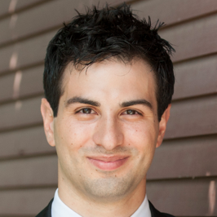
Beacon project
A Beacon is a discovery service for genetic variants
Developing tools to make data discoverable
Aiding data sharing
Increasing efficiency in data access process
https://beacon-network.org www.elixir-europe.org/beacons
Led by:
Serena Scollen
Head of Human Genomics and Translational Data, ELIXIR
Marc Fiume
Co-founder and CEO DNAstack

Slide 3
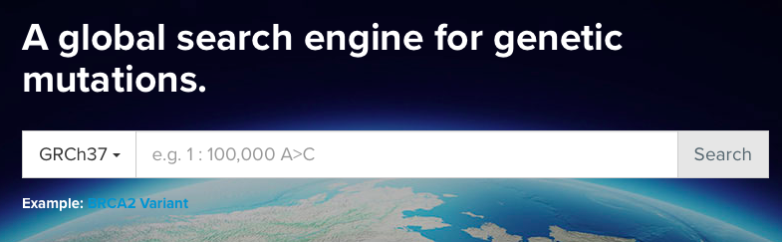


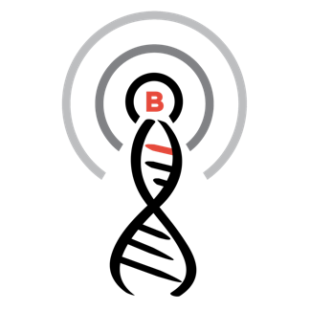

Public data discovery web-service
Do you have information about the allele “C at position 32,936,732 on chromosome 13?”
Do you have information about the allele “C at position 32,936,732 on chromosome 13?”
Yes / No
(+optional metadata about the allele)
Beacon X: Yes
Beacon Y: No
Beacon Z: No
…
https://beacon-network.org

Slide 4


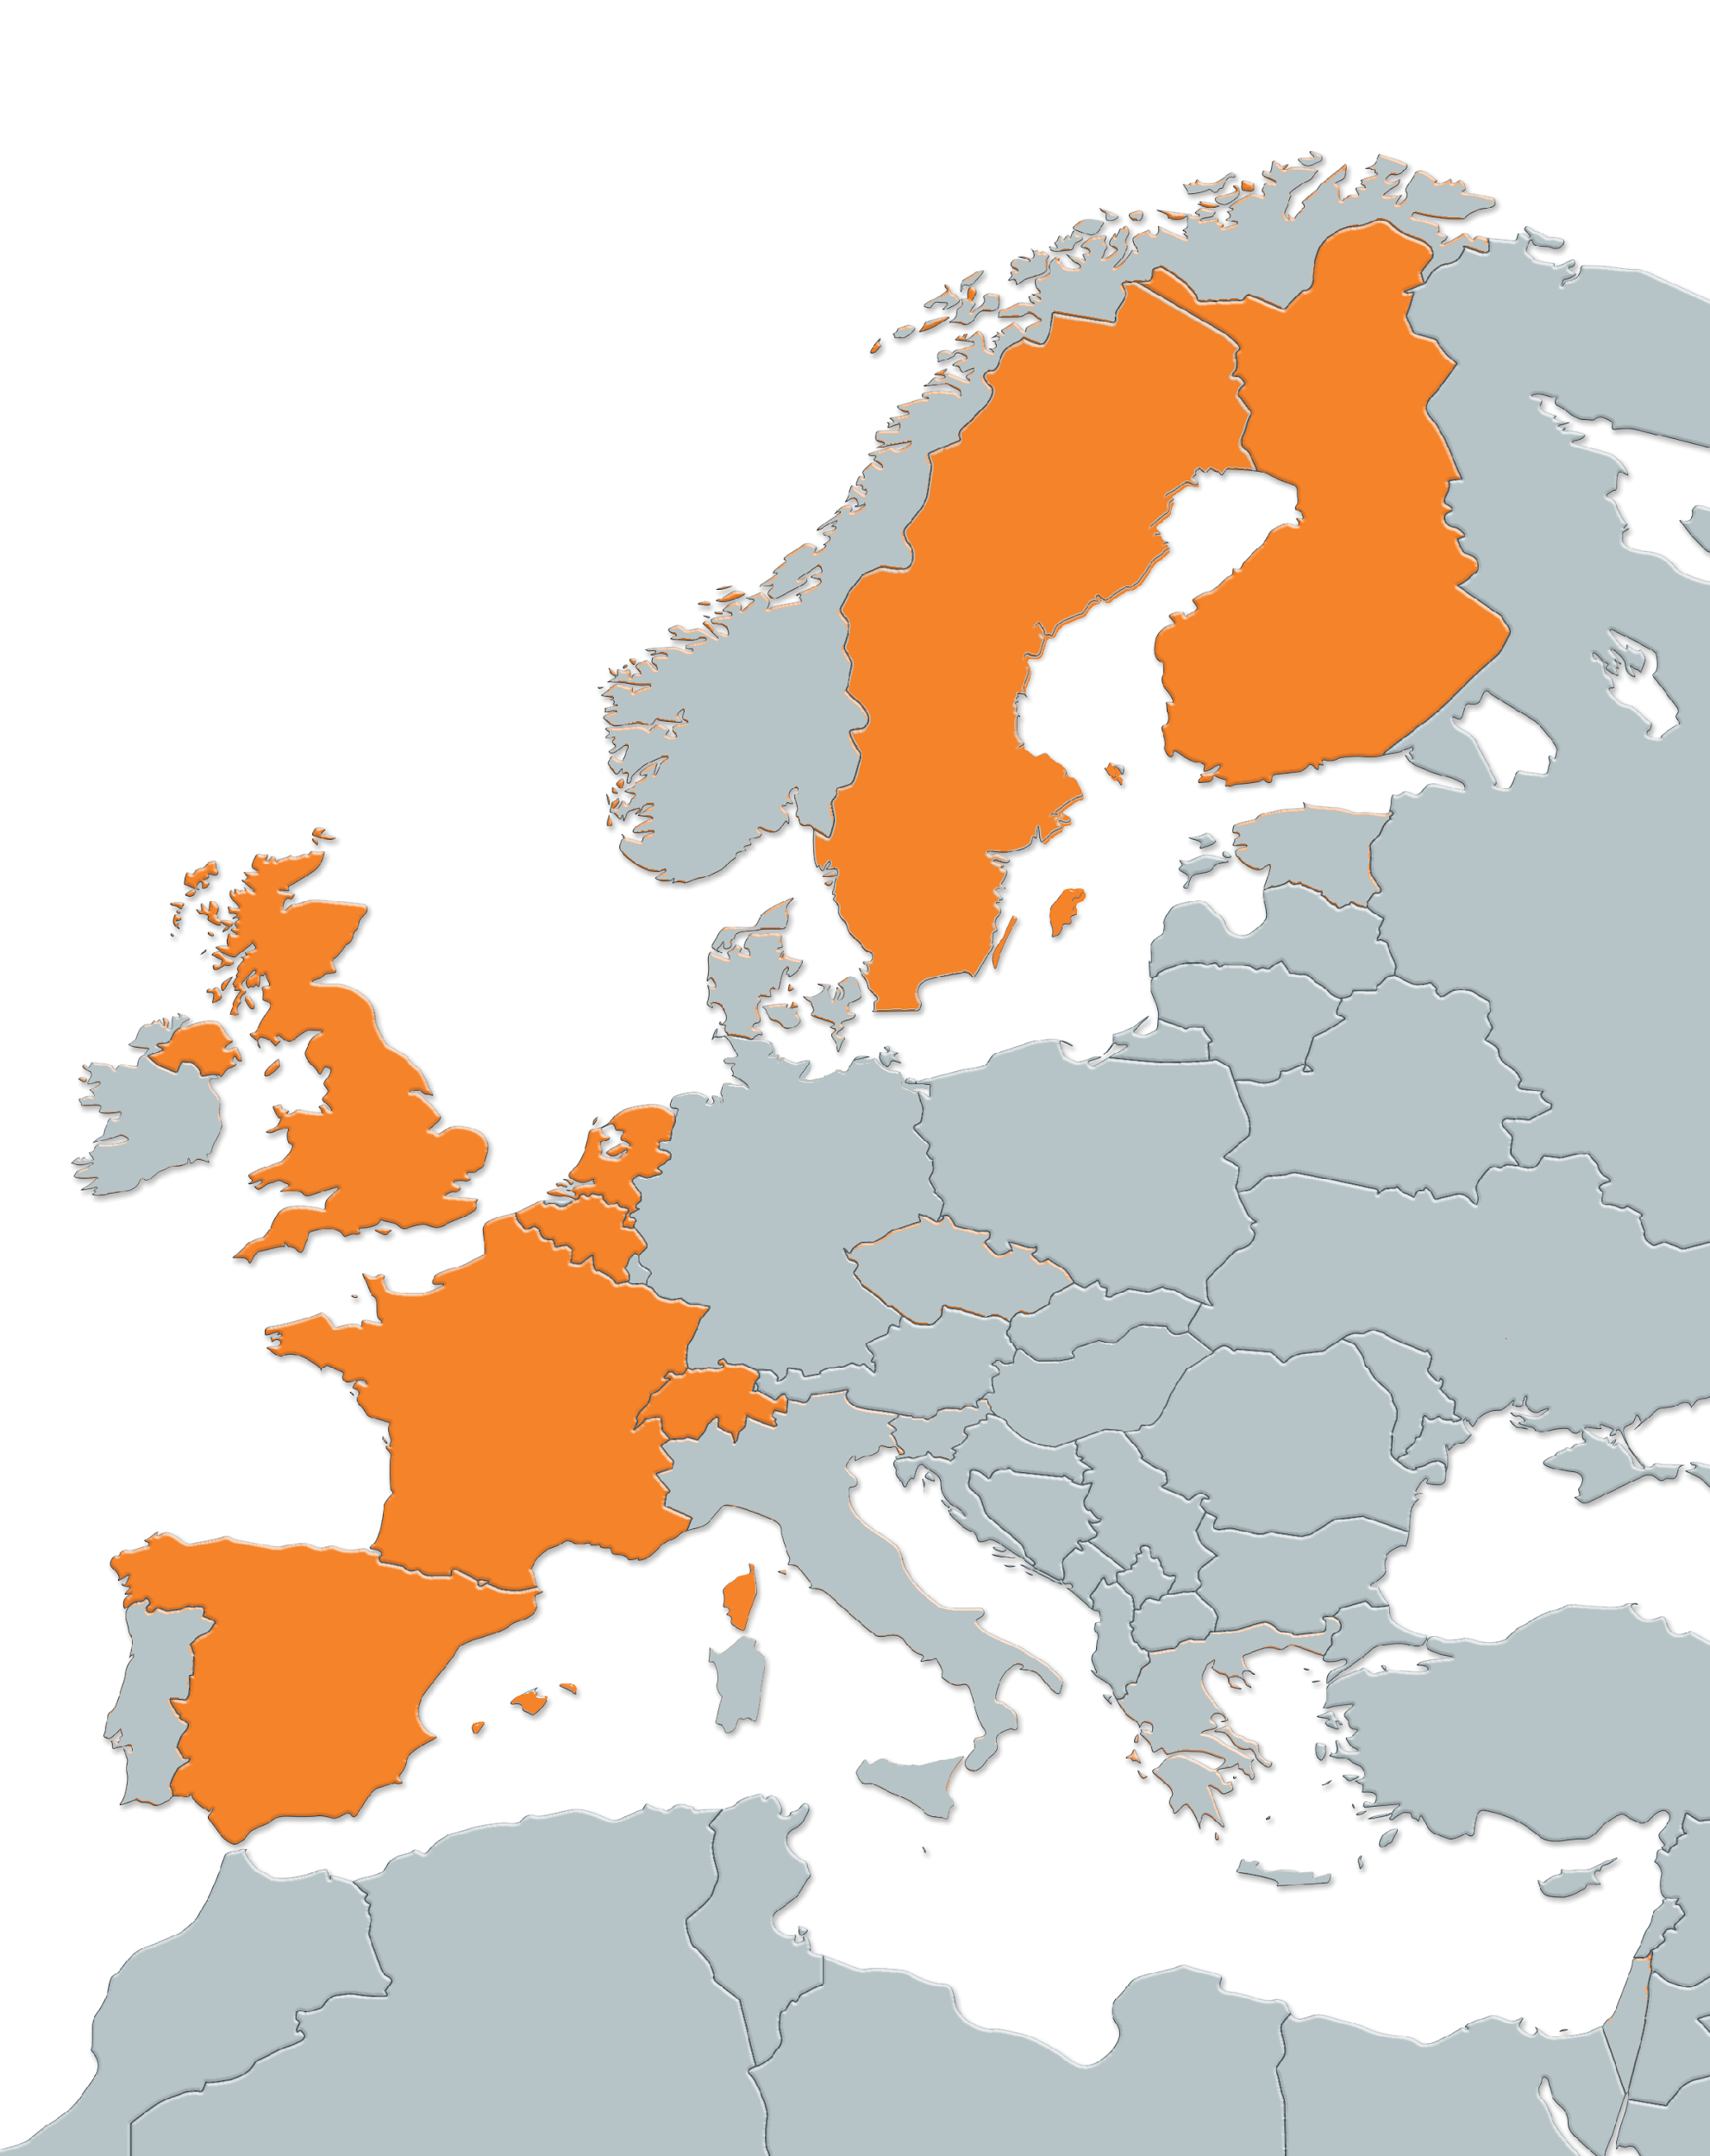






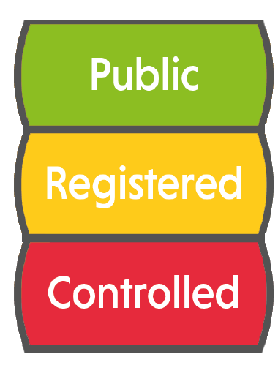



ELIXIR and Beacons
Funding to drive implementation of the Beacon technology within ELIXIR nodes
ELIXIR Authentication and Authorization Infrastructure
Accessible to internet users
Accessible to bona fide researchers
Authorized – signed agreement needed
Press release: https://www.elixir-europe.org/news/elixir-beacons-facilitate-sharing-genomics-data-europe
www.elixir-europe.org/beacons

Slide 5
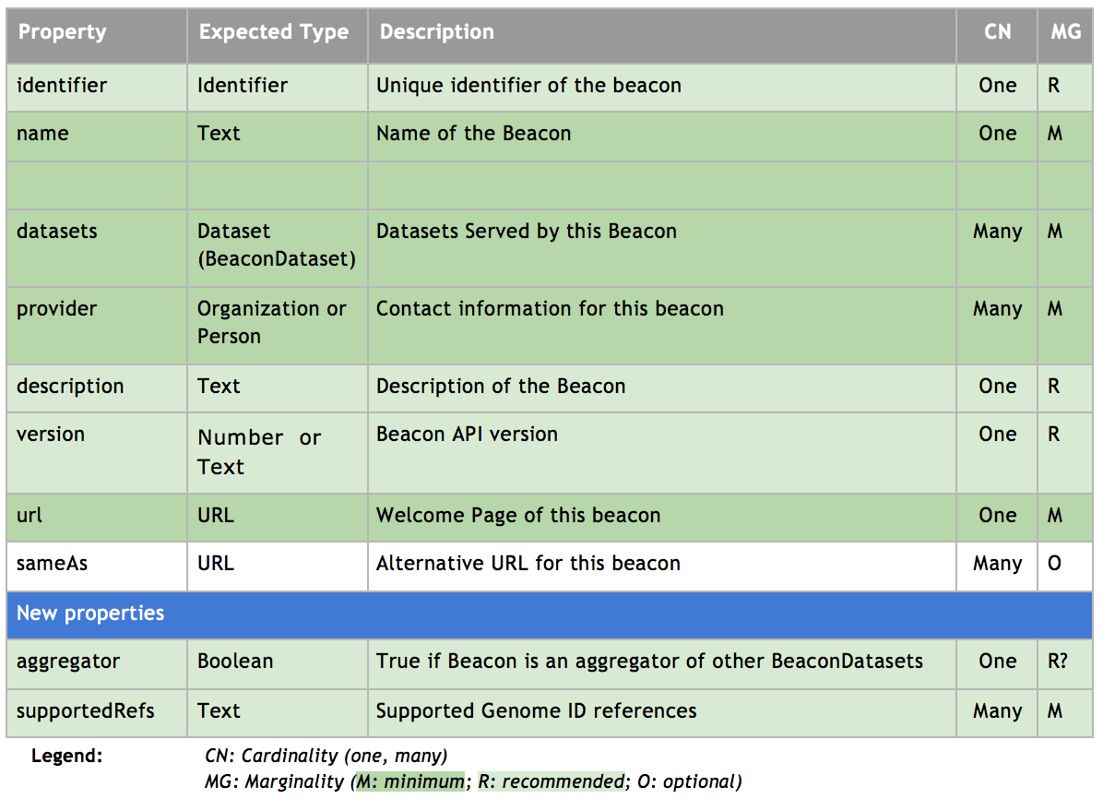
Beacon Description 0.1
<script type="application/ld+json">
{
“@context": “http://bioschemas.org”,
“@type”: “Beacon”,
“identifier”: “ega”,
“name: “European Genome-Phenome Archive”,
"description": “”,
“url”: “https://ega.crg.eu/beacon_web/”,
“version”: “”,
“provider”: [{
"@type": "Organization",
"name": "EMBL-EBI",
"contactPoint":{"email":"","name":""}
"description":"",
"url":"http://www.ebi.ac.uk/",
"address":"",
"logo":"https://upload.wikimedia.org/wikipedia/en/1/1b/Ebi_official_logo.png"
},{
"@type": "Organization",
"name": "CRG",
"contactPoint":{"email":"","name":""}
"description":"",
"url":"https://ega.crg.eu",
"address":"",
"logo":""
}
],
“datasets”: [
{
“@context": “http://bioschemas.org”,
“@type”: “BeaconDatasets”,
“identifier”: “EGAD00001000227”,
...
},
...
],
“supportedRefs”: “HG19”,
“aggregator” : False
}
</script>

Slide 6
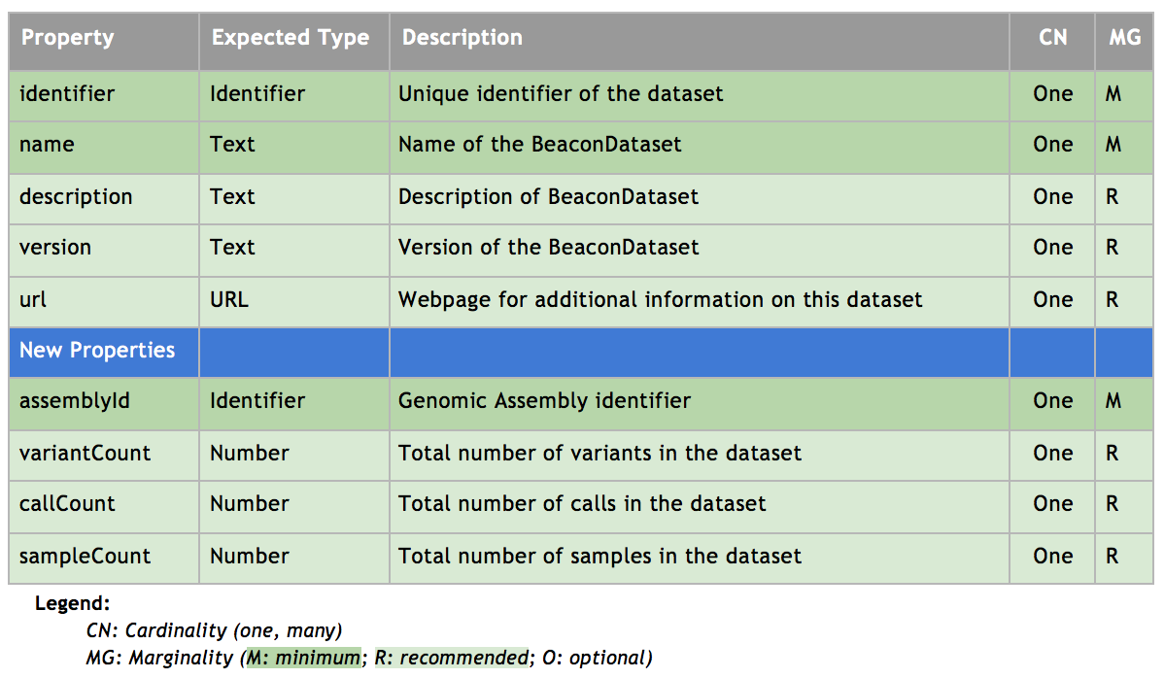
BeaconDataset Description 0.1
<script type="application/ld+json">
{
“@context": “http://bioschemas.org”,
“@type”: “BeaconDatasets”,
“identifier”: “EGAD00001000227”,
“name: “EGAD00001000227_UK10K_NEURO_ABERDEEN_REL_2012_07_05”,
"description": “”,
“url”: “https://ega-archive.org/datasets/EGAD00001000227”,
“assemblyId”: “HG19”,
“variantCount”: “”,
“callCount”: “”,
“sampleCount”: “347”,
“version”: “v1”,
}
</script>

Slide 7
Progress towards specification development
To be Done
Use Cases
Mapping/Crosswalk
Testing
Specification
First Draft Beacon & BeaconDataset Bioschema specification completed
Beacon spec. overlaps with schema://DataCatalog or bioschema://DataRepositories
BeaconDataset overlaps with schema://Dataset or bioschema://Dataset
Adoption
Pull request ready to be sent to ELIXIR Beacon UI reference Implementation
This would be part of the testing process

Slide 8
Thank you!
Susheel Varma (ELIXIR-Hub)
audald.lloret@crg.eu

